Slide 1
第1课
LabVIEW导航
了解LabVIEW编程环境的主要组成部分，学会创建项目和VI。
LabVIEW是什么？
项目浏览器
VI的组成部分
前面板
程序框图
搜索控件、VI和函数

Slide 2
A. LabVIEW是什么？
了解LabVIEW的优点。

Slide 3
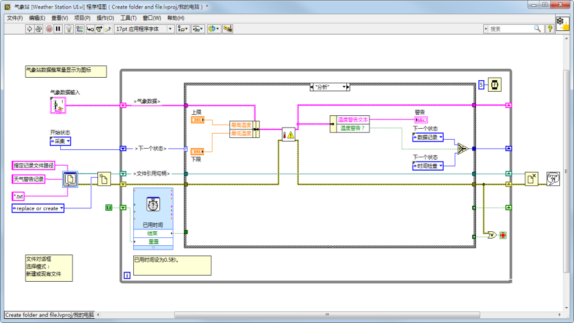
A. LabVIEW是什么？
LabVIEW的优点
与多种硬件实现连接
可在不同的终端和操作系统间切换
提供内置的分析库

Slide 4
A. LabVIEW编程环境
LabVIEW语言特点
LabVIEW
核心教程（一）主题
图形化
同步
LabVIEW
核心教程（二）及后续主题
多线程
面向数据流
编译
多平台
面向对象
多终端
实现管理内存
事件驱动

Slide 5
活动1-1
树立信心：创建一个VI
创建一个应用程序，计算两个数的乘积。

Slide 6
B. 项目浏览器
认识项目浏览器的主要组成部分。
LabVIEW文件
项目文件夹

Slide 7
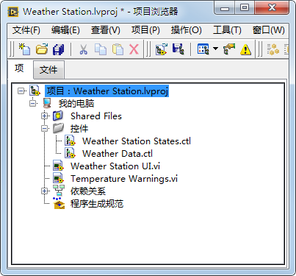
B. 项目浏览器
LabVIEW文件
LabVIEW项目：.lvproj
虚拟仪器 (VI)：.vi
自定义控件：.ctl
Notes:
LabVIEW uses many different types of files. In this class you will learn about three different LabVIEW files – LabVIEW projects, VIs, and custom controls.
Historically, LabVIEW programs are called virtual instruments, or VIs, because their appearance and operation imitate physical instruments, such as oscilloscopes and multimeters. Today LabVIEW VIs can be extremely powerful and sophisticated programs with elegant graphical user interfaces.
Later in this course you learn how custom controls can improve maintainability of your LabVIEW application.
LabVIEW projects can also include non-LabVIEW file types. For example, you can include documentation files.
Note: If students need to work with legacy code, you might briefly cover .llb files.

Slide 8
使用项目浏览器和创建VI
在LabVIEW中创建项目和VI。
Notes:
Start with the Getting Started window and demonstrate selecting the Create Project button and the Open Existing button. Open the Weather Station project (Weather Station.lvproj) solution file to use for this demonstration (Solution 7-1, No HW). Open the Weather Station UI.vi and identify the three parts of a VI – front panel, block diagram, and icon/connector pane.
Add a blank VI, an existing VI, a text file, and remove a file from the project. Be sure to demonstrate that changes made in the Project Explorer window on the Items tab do not reflect how the files are saved on disk. Also, demo the difference between adding/creating virtual folders and adding an auto-populating folder. Demo the difference between the Items tab and the Files tab (The Files tab displays the location of project folders on disk. Project operations on the Files tab both update and reflect the contents of the folder on disk).
NOTE: Do not save the project so that you do not affect your project solution.
Demonstrate the ability to start a VI in LabVIEW the following ways:
From within a project, right-click on My Computer and select New»VI.
With project open, select New VI from File menu.

Slide 9
B. 项目浏览器
添加文件夹至项目
虚拟文件夹
自动更新文件夹

Slide 10
C. VI的组成部分
认识和理解前面板与程序框图的区别。

Slide 11
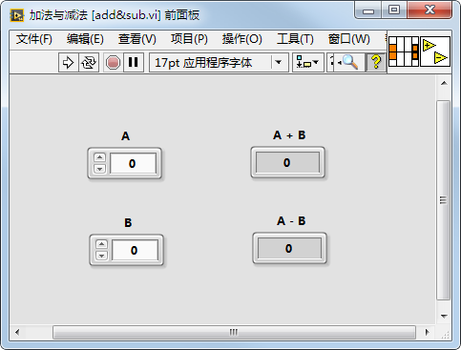
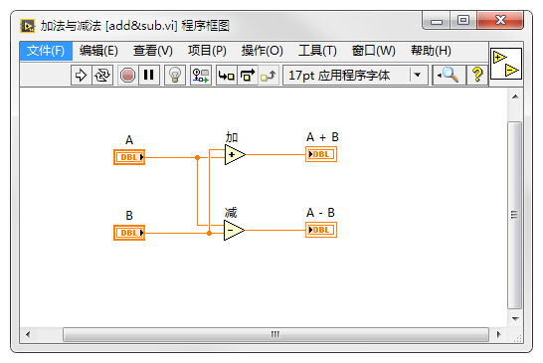
VI的组成部分
图标/连线板
程序框图
前面板

Slide 12
D. 前面板
认识前面板窗口的组成部分及其功能，学会选择合适的输入和显示控件。
前面板窗口工具栏
输入控件和显示控件
字符串型、布尔型和数值型
前面板对象样式

Slide 13
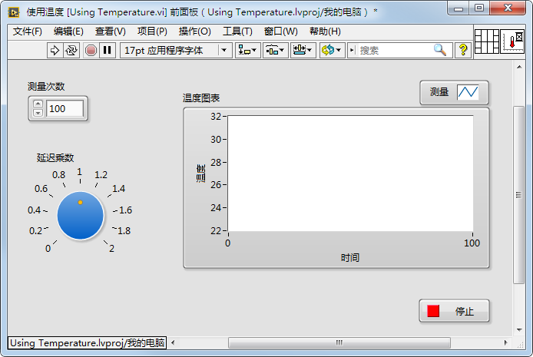
D. 前面板
前面板窗口工具栏

Slide 14
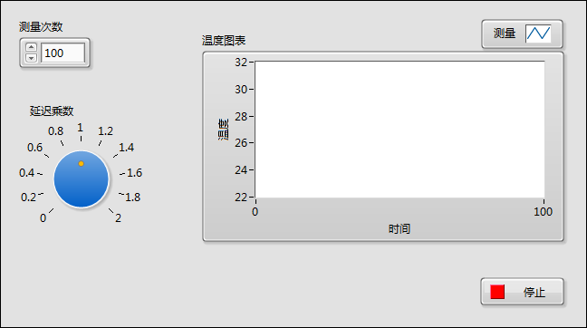
D. 前面板
输入控件和显示控件
输入控件：输入
显示控件：输出
Notes:
Engage the students in identifying controls and indicators on this front panel.
In the next few slides, you discuss basic data types: numerics, strings and Booleans. Discuss only front panel information here, such as appearance and what type of data you put in the control or indicator.
You discuss representation, mechanical action, and string display types in the next lesson.

Slide 15
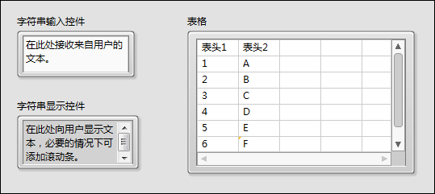

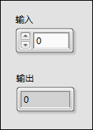
D. 前面板
字符串型、布尔型和数值型
布尔
输入控件
布尔
显示控件
增量/减量按钮
数值输入控件
数值显示控件
Notes:
The numeric data in a control or indicator can represent numbers of various types, such as integer or floating-point.

Slide 16
活动1-2
选择前面板对象
根据不同问题描述选择合适的数据类型，并判断前面板对象应为输入控件还是显示控件。

Slide 17
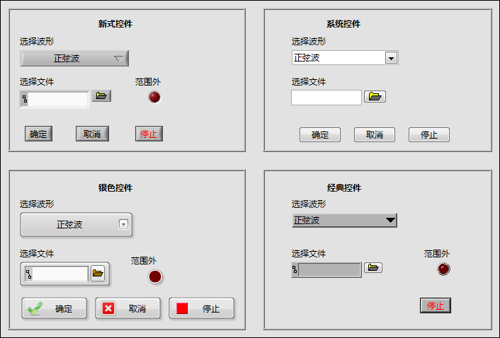
D. 前面板
前面板对象样式
Notes:
LabVIEW has different control palettes with objects for building user interface, including the Modern, Silver, Classic, and System palettes.
The controls and indicators on the Silver palette are the newest to LabVIEW. They provide a rich user interface. Because of the added glyphs, the Silver objects tend to be a little larger than other styles.
Use objects from the System palette when you want a dialog that matches your operating system. The System controls (also known as dialog controls) change appearance depending on which platform you run the VI. For example, when running on a Mac OS, the controls adapt a different color and appearance than they have on a Windows OS so that they match the appearance of the Mac OS system.
Not all palettes have the same options. For example, the System palette does not have a LED.
Similarly, if you use Quick Drop, you will notice multiple options. The new Silver controls will have “Silver” in the parentheses.
Instructor Note:
Demonstrate Quick Drop functionality. Press <CTRL>-Space and type “LED” in the Quick Drop window. Show how to select the Silver-style LED.

Slide 18
E. 程序框图
认识程序框图的特点，学会选择函数。
程序框图工具栏
程序框图的组成部分
Express VI
节点外观
连线
即时帮助和LabVIEW帮助
范例

Slide 19
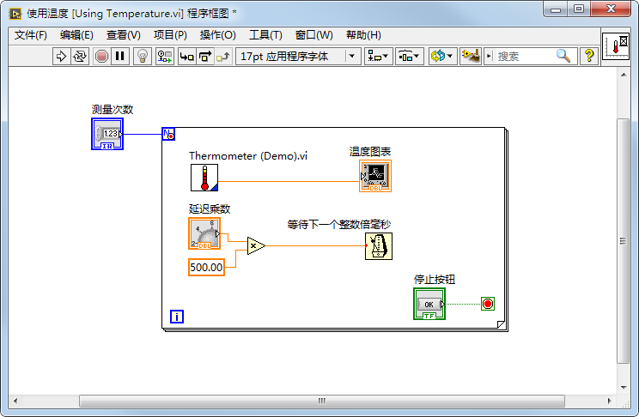
E. 程序框图
程序框图工具栏
Notes:
Briefly mention the functionality of the items on the toolbar:
Run, Run Continuously, Abort Execution, Pause, Highlight Execution, Retain Wire Values, Step Into, Step over, Step Out, Text Settings, Align Objects, Distribute Objects, Reorder, Clean Up Diagram
Students learn about debugging tools in the next lesson. Use next slide to discuss different objects on block diagram.
Click the Run button to run the VI. LabVIEW compiles the VI, if necessary. You can run a VI if the Run button appears as a solid white arrow. If the Run button appears broken, the VI contains edit-time errors. Students learn about fixing edit-time errors in the next lesson.

Slide 20
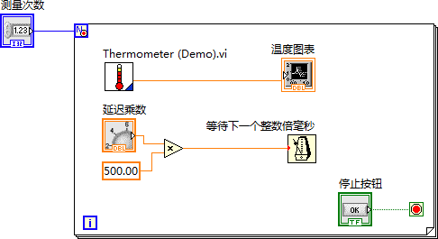
程序框图的组成部分
Notes:
Objects on the block diagram include terminals and nodes. You build block diagrams by connecting the objects with wires. The color and symbol of each terminal indicate the data type of the corresponding control or indicator. Constants are terminals on the block diagram that supply fixed data values to the block diagram.
Nodes are objects on the block diagram that have inputs and/or outputs and perform operations when a VI runs.

Slide 21

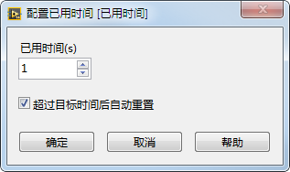
E. 程序框图
Express VI

Slide 22



E. 程序框图
节点外观
图标
可扩展节点

Slide 23

E. 程序框图
连线
连线用于在程序框图对象间传递数据。
断线：
浮点
整型
字符串型
布尔型
标量
一维数组
二维数组

Slide 24
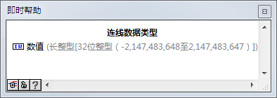
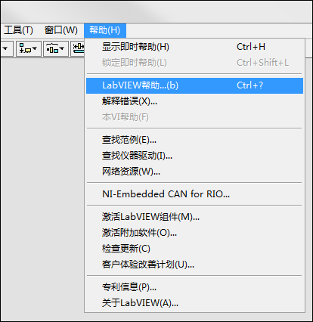
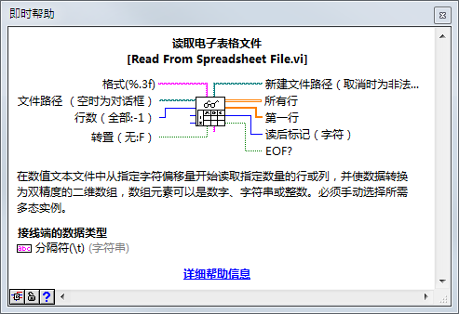
即时帮助和LabVIEW帮助

Slide 25
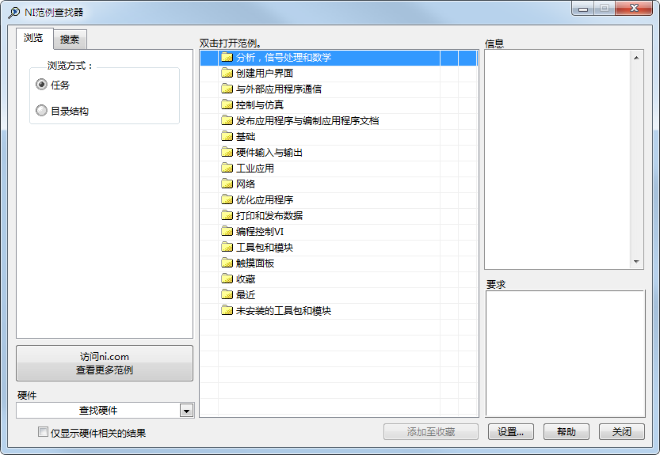
E. 程序框图
范例
使用NI范例查找器（帮助»查找范例）浏览和查找安装的范例。
Notes:
Use the NI Example Finder to search all installed examples and examples located in the NI Developer Zone on the web.
Modify any example VI to fit an application, or copy and paste from an example into a VI that you create.
Methods of accessing the NI Example Finder:
Select Help»Find Examples
Click the Find Examples link in the Getting Started window
You can access examples using the Open example and Find related examples buttons located at the bottom of certain VI and function reference topics in the LabVIEW Help. Click the Open example button to open the example VI to which the topic refers. Click the Find related examples button to open the NI Example Finder and display related example VIs.

Slide 26
练习1-1
认识VI
识别VI的各个组成部分。

Slide 27
练习1-1
认识VI
什么是常量？应在何时使用常量？
什么是自由标签？应在何时使用自由标签？

Slide 28
F. 搜索控件、VI和函数
搜索需要的输入控件、显示控件及函数。
选板
快速放置
NI全局搜索

Slide 29
搜索控件、VI和函数
使用选板、“快速放置”和全局搜索演示如何搜索控件、VI和函数。

Slide 30
练习1-2
搜索控件、函数和VI
学会通过选板搜索控件、函数和VI。

Slide 31
练习1-2
搜索控件、函数和VI
为何有时要将函数添加至函数选板的收藏类别？
为何有时要使用快速放置对话框，而不用控件和函数选板上的搜索按钮？

Slide 32

活动1-3
课程回顾
参考学员指南回答本课所学内容的相关问题，并分组进行讨论。

Slide 33
课程回顾
VI的三个组成部分是什么？
前面板
程序框图
项目
图标/连线板
Notes:
The answer is a, b, and d.

Slide 34
课程回顾
VI的三个组成部分是什么？
前面板
程序框图
项目
图标/连线板
Notes:
The answer is a, b, and d.

